Slide 1
Ani Domain is Back to University!
Notes:
Ани
1996
Учителка, Посолство, мениджър

Slide 2
Notes:
- ЕК
- кариера/ умения

Slide 4
The EU institutions
Европейски съвет (summit)
Европейски парламент
Съвет на министрите
(The Council)
Европейска Комисия
Съд на Европейския съюз
Европейска сметна палата
Икономически и социален комитет
Агенции
Европейска инвестиционна банка
Комитет на регионите
Европейска централна банка

Slide 6
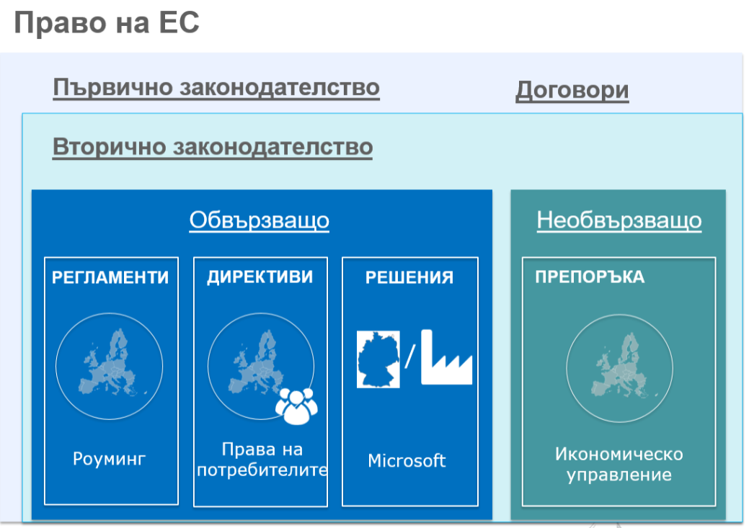

Slide 7
https://blogs.ec.europa.eu/ECintheUK/euromyths-a-z-index/
Dominic Cummings, the Vote Leave campaign director, described the EU referendum as a “dumb idea” in a series of tweets, and said other options should have been tried out first before the vote was called.
Notes:
Stay informed
Use various sources
Check the sources
Analyse

Slide 8
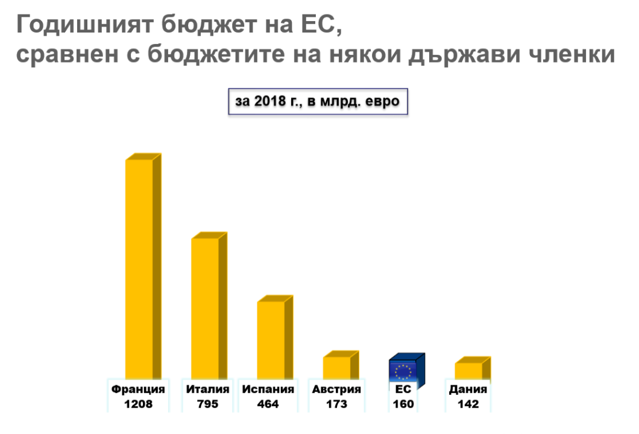
http://www.europarl.europa.eu/external/html/budgetataglance/default_en.html#bulgaria

Slide 9
https://europa.eu/euandme/frontpage_bg
Notes:
https://europa.eu/euandme/frontpage_bg

Slide 10
Erasmus+
The EU programme for
Education, Training, Youth and Sport
2014-2020

Slide 11
Erasmus+ and the European Solidarity Corps
Violeta Birzniece, Unit B3
DG Education, Youth, Sport and Culture
Notes:
In 2014 a study showed Erasmus is responsible for 1 000 000 000 » Erasmus babies »

Slide 12
#EUSOLIDARITYCORPS
http://europa.eu/youth/solidarity

Slide 13
WHICH ACTIONS ARE SUPPORTED?
Volunteering
Traineeships and Jobs
Solidarity Projects

Slide 14
What do you get as a volunteer?
An experience of a lifetime!

Slide 15
HOW DOES IT WORK IN PRACTICE?
Register for the European Solidarity Corps:
europa.eu/solidarity-corps
For the European Solidarity Corps Guide and if you want to apply for funding as an organisation or a group of young people (for solidarity projects):
ec.europa.eu/youth/solidarity-corps

Slide 16
Стажове в Европейските институции https://epso.europa.eu/job-opportunities/traineeships_bg
Notes:
https://epso.europa.eu/job-opportunities/traineeships_bg

Slide 17
https://ec.europa.eu/stages/home_en
Notes:
https://ec.europa.eu/stages/home_en
Unpaid traineeships (tbc)
Advantages

Slide 18
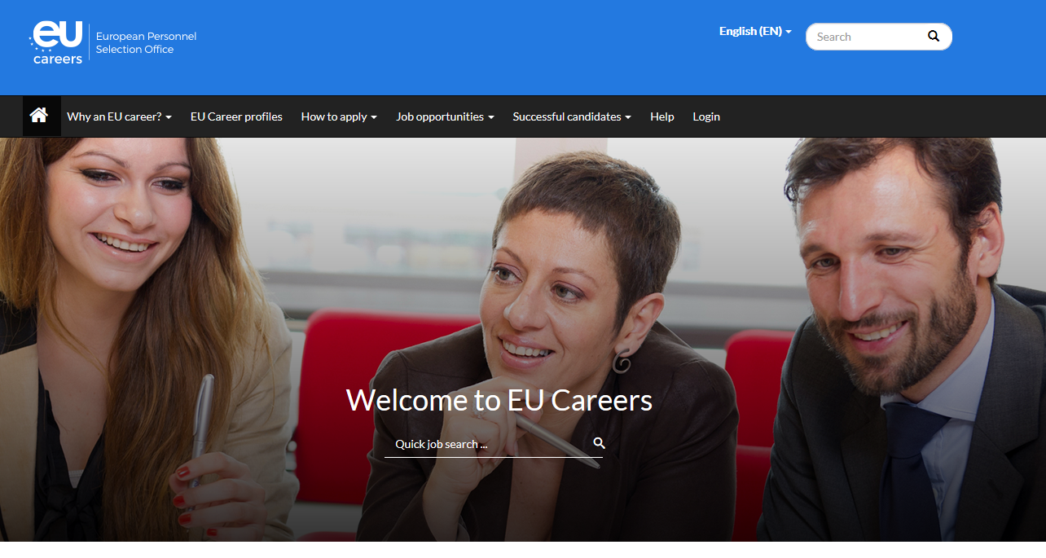
https://epso.europa.eu/home_en
Notes:
EPSO
Model tests for benchmarking

Slide 19
EU Careers Student Ambassadors
- Act as a point of contact for students interested in EU Careers
- Research target groups and contact university media
- Set up mailing lists and distribute information on EU Careers --through the appropriate channels
- Give presentations, attend university careers events and find interesting speakers
- Complete monthly tasks and regularly report back on your activities
- Manage and regularly monitor a dedicated Facebook page / online presence

Slide 23
https://europa.eu/youth/working_bg
Notes:
https://europa.eu/youth/working_bg

Slide 25
The European Research Council
Dedicated to selecting and funding the excellent ideas that have not happened yet and the scientists that are dreaming of them

Slide 26
The « Learning Corner » portal

Slide 27
Ani’s
Notes:
Never stop learning - new languages, skills, jobs
Be curious, stay well informed, analyse
Look for opportunities, ask around, apply
Get out of your comfort zone – take up new tasks, be flexible and adaptive
« I will prepare and someday my chance will come »

Slide 28
Useful links and contacts: https://www.consilium.europa.eu/bg/council-eu/ https://ec.europa.eu/info/index_bg https://www.europarl.europa.eu/portal/en https://blogs.ec.europa.eu/ECintheUK/euromyths-a-z-index/ https://europa.eu/euandme/frontpage_bg ec.europa.eu/youth/solidarity-corps https://epso.europa.eu/job-opportunities/traineeships_bg https://ec.europa.eu/stages/home_en https://epso.europa.eu/home_en https://prometric.com/epso/EPSO-AD-Cycle-Self-Assessment https://europa.eu/youth/working_bg https://ec.europa.eu/research/mariecurieactions/how-to/find-job_en https://erc.europa.eu/funding/starting-grants https://europa.eu/learning-corner/home_bg

Slide 29
Благодаря ви за вниманието! Ani.Domain@ec.europa.eu

